Slide 1
IMPROVE Data Processing
Ryan Templeton
6/29/2017

Slide 2
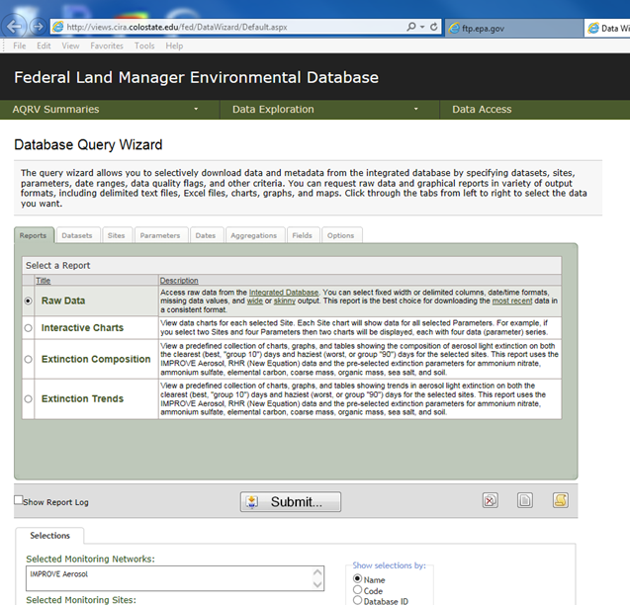
Federal Land Manager Environmental Database
http://views.cira.colostate.edu/fed/DataWizard/Default.aspx
The federal land manager environmental database contains raw and processed IMPROVE datasets for States to utilize
The following slides show the steps one should take to download FLM data for processing in the “XXXXX RXRIII IMPROVE.xlsm” workbook
Access the database and select the ‘Raw Data’ option in the ‘Reports’ tab:

Slide 3
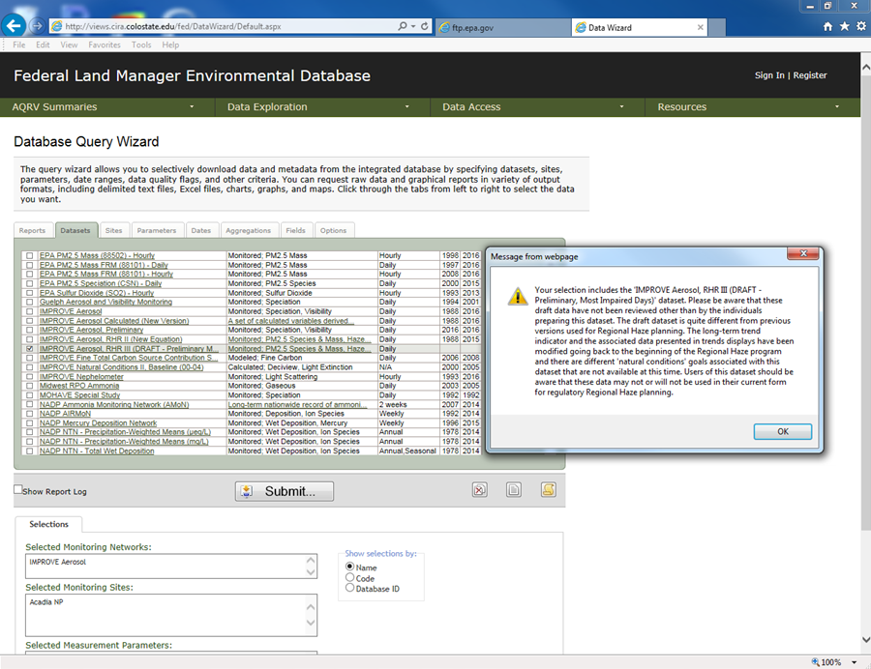
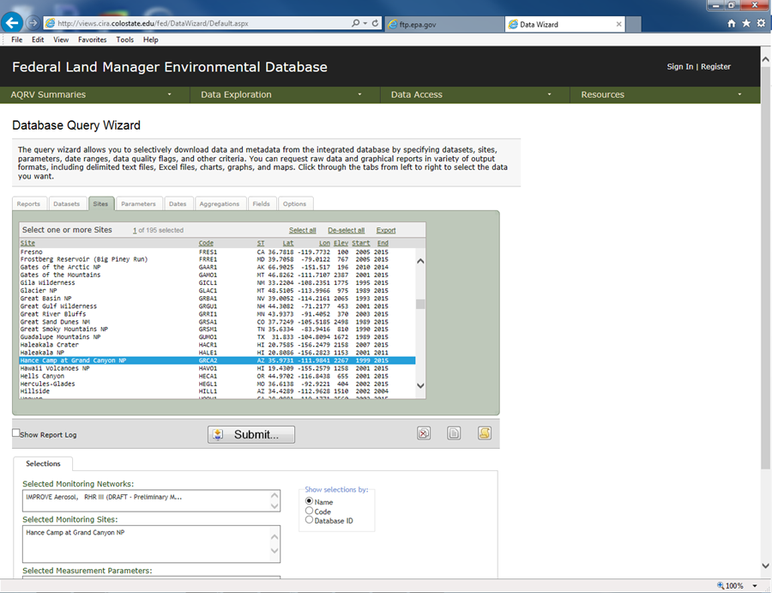
FLM Database Data Download
Datasets: IMPROVE Aerosol, RHR III (New Equation)
Sites: <Select Site of Interest>

Slide 4
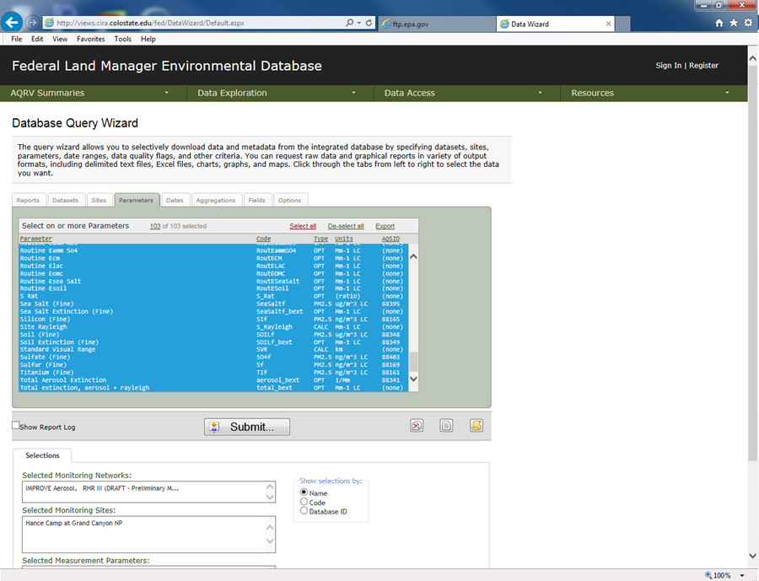
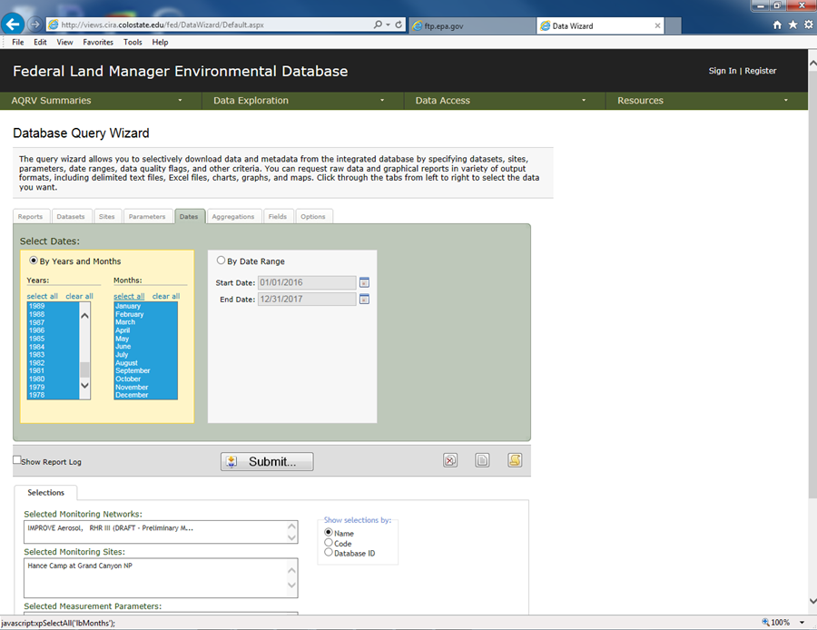
FLM Database Data Download Continued
Parameters: Select All
Dates: Select all Years & Months

Slide 5
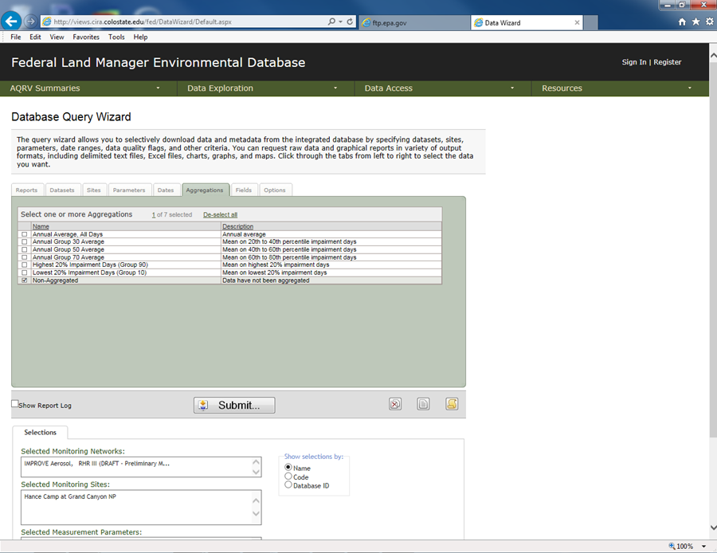
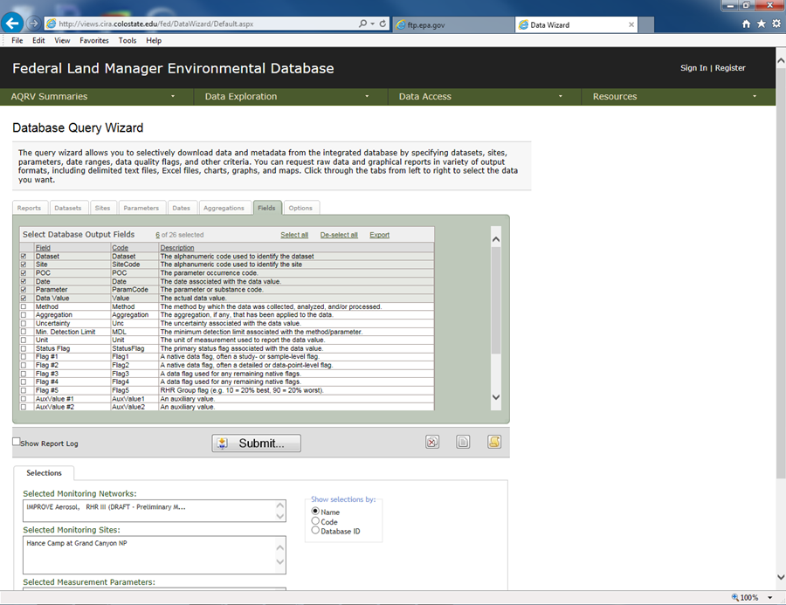
FLM Database Data Download Continued
Aggregations: Non-Aggregated
Fields: (default) – Dataset, Site, POC, Date, Parameter, Data Value

Slide 6
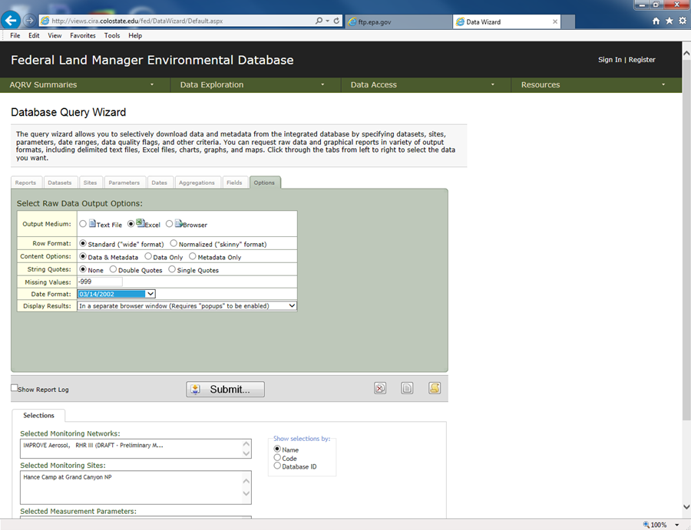
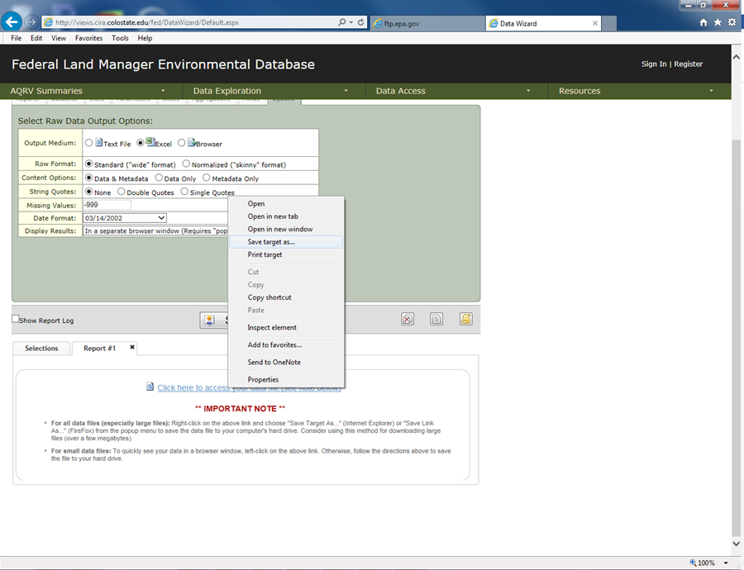
FLM Database Data Download Continued
Options: Output Medium – Excel, Date Format – 03/14/2002, all others default
“Submit…” and then right click on download prompt and “Save target as…”

Slide 7
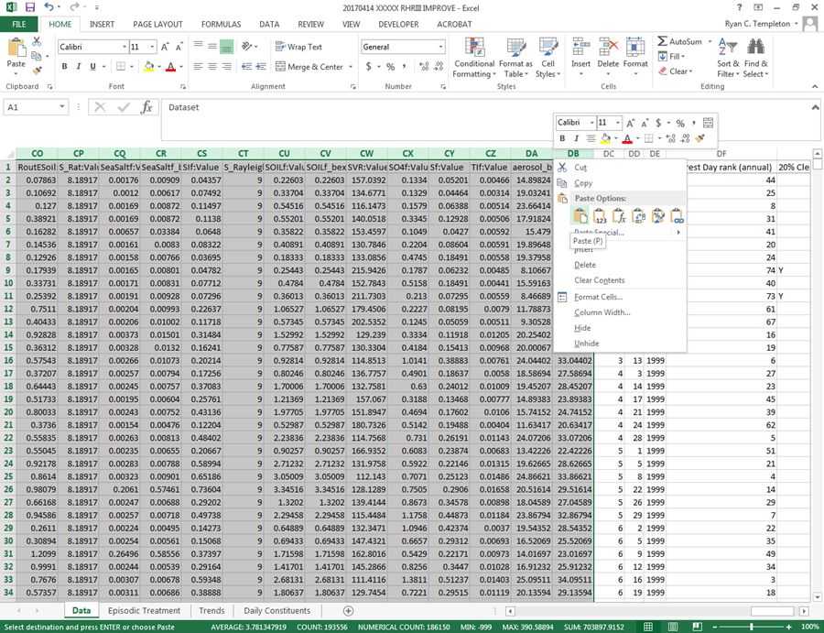
IMPROVE Data Transfer
Access the downloaded file, navigate to the ‘Data’ worksheet and copy columns A:DB only
Paste this data into columns A:DB of the ‘Data’ worksheet of the “….XXXX RHRIII IMPROVE.xlsm” workbook

Slide 8
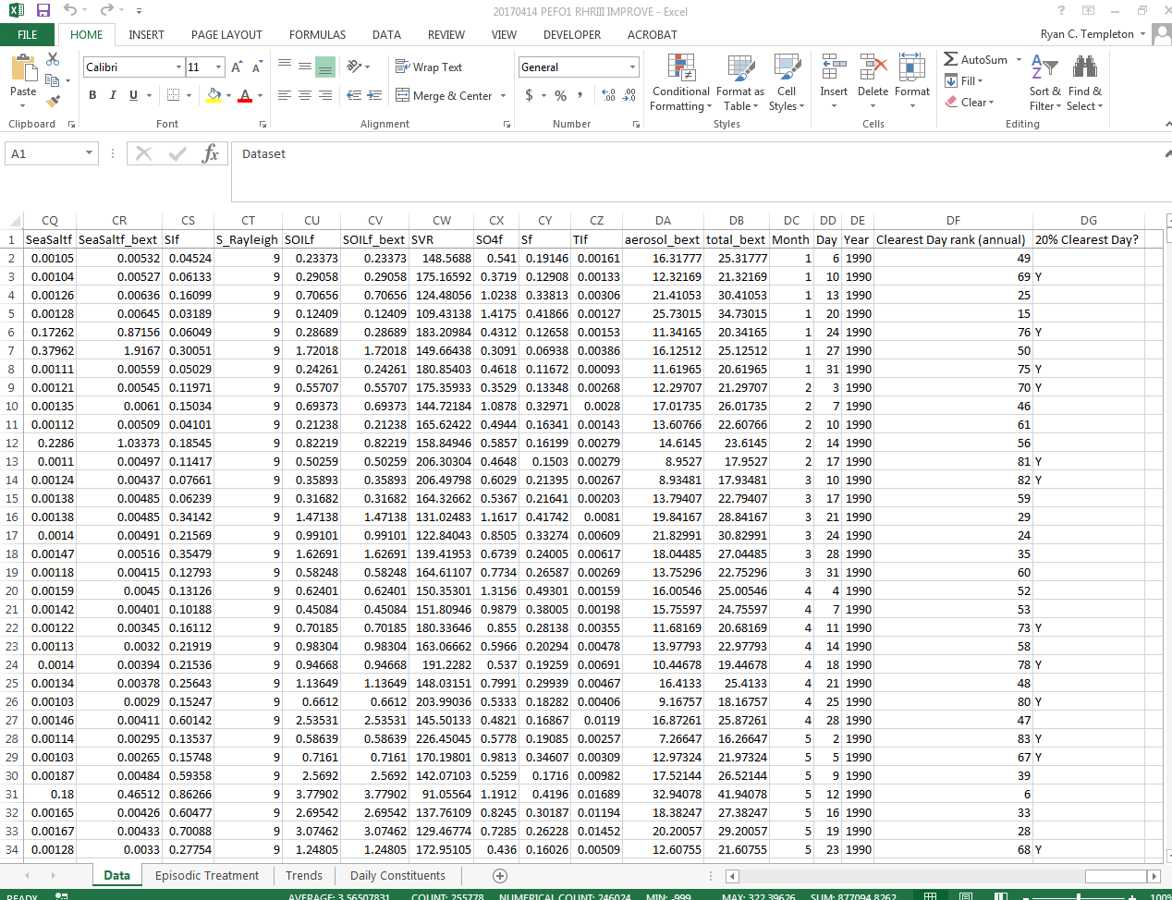
‘Data’ Worksheet
This spreadsheet includes all of the IMPROVE raw and processed data downloaded from the FLM website.
Columns A:DB contain data imported from the FLM IMPROVE monitor database.
Columns DC:DG process the FLM data in order to determine the Clearest Days for each year.

Slide 9
‘Episodic Treatment’ Worksheet
This worksheet processes the data for the 20% most impaired days and estimates natural and anthropogenic extinction (Mm⁻¹) and impairment (dv).
The calculations follow EPA’s methodologies outlined in Sections 5.5 and 5.6 of the 2016 draft Regional Haze Guidance¹ (Guidance) and Section 2.1 of the accompanying Technical Support Document² (TSD).
The user has the ability to modify the episodic threshold for carbon and dust (default setting of 95%); however, the spreadsheet ignores adjustment of the URP for prescribed fire and international transport.

Slide 10
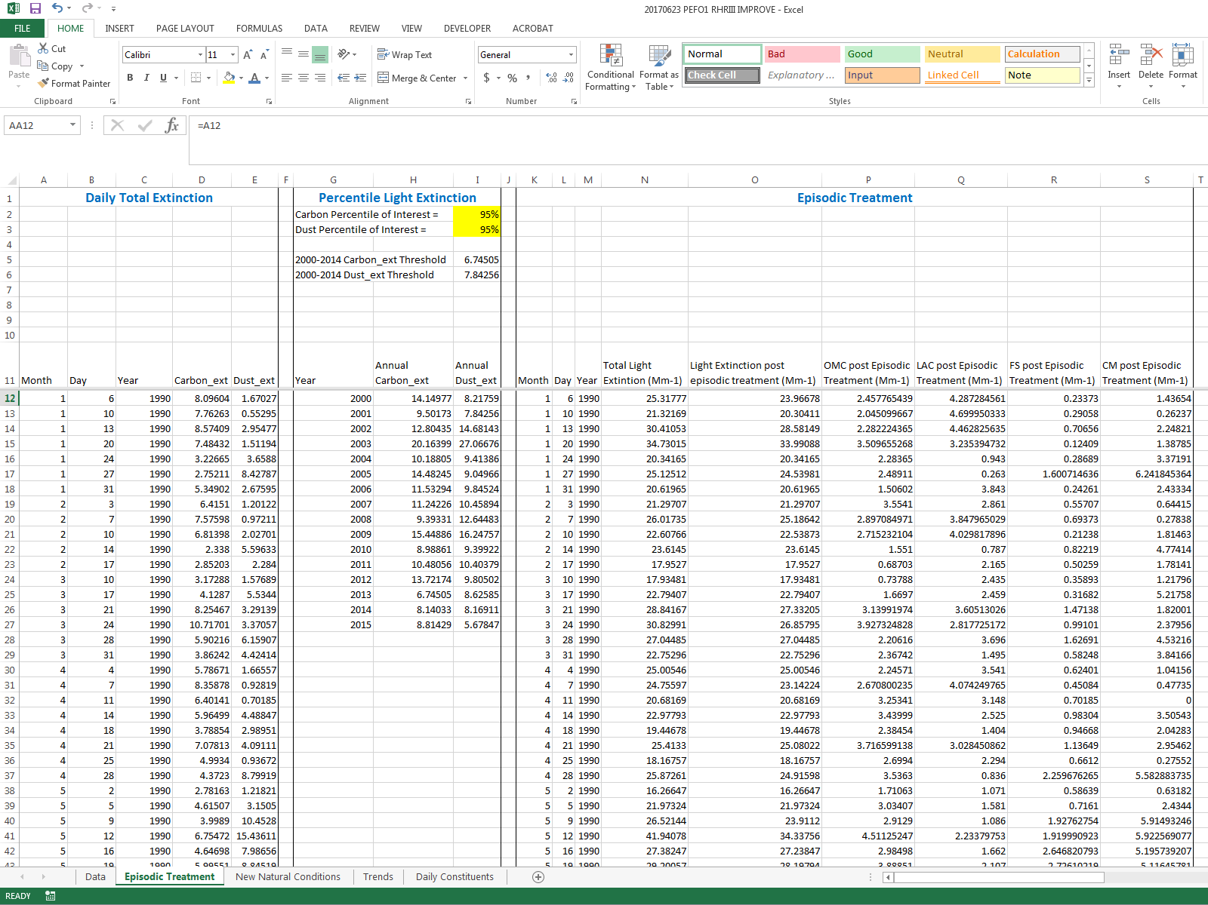
‘Episodic Treatment’ Worksheet Continued
Daily Total Extinction – Calculates the daily Carbon and Dust extinction (Mm⁻¹), Step A of the Guidance
Percentile Light Extinction – Determines the 95% values for carbon and dust extinction for each year, Step A of the Guidance. The 95% threshold can be changed by the user to test the effects of different thresholds.
Episodic Treatment – Removes the any daily carbon or dust in excess of the threshold values in cells I5 and I6. Redistributes extinction to species. Steps B & C of the Guidance.

Slide 11
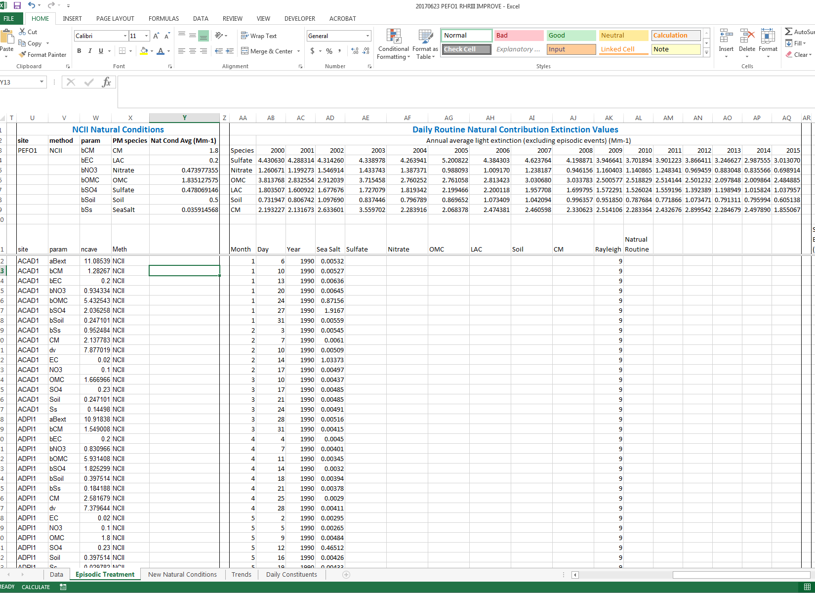
‘Episodic Treatment’ Worksheet Continued
NCII Natural Conditions – Isolates the revised haze natural condition estimates for the monitor of interest, Step D of the Guidance.
Daily Routine Natural Contribution Extinction Values – Estimates daily routine natural extinction for each pollutant, Step D of the Guidance and Section 2.1.2 of the TSD. If the daily pollutant extinction is less than NCII value, then the daily value is all considered natural routine. Otherwise, the following equation is utilized:

Slide 12
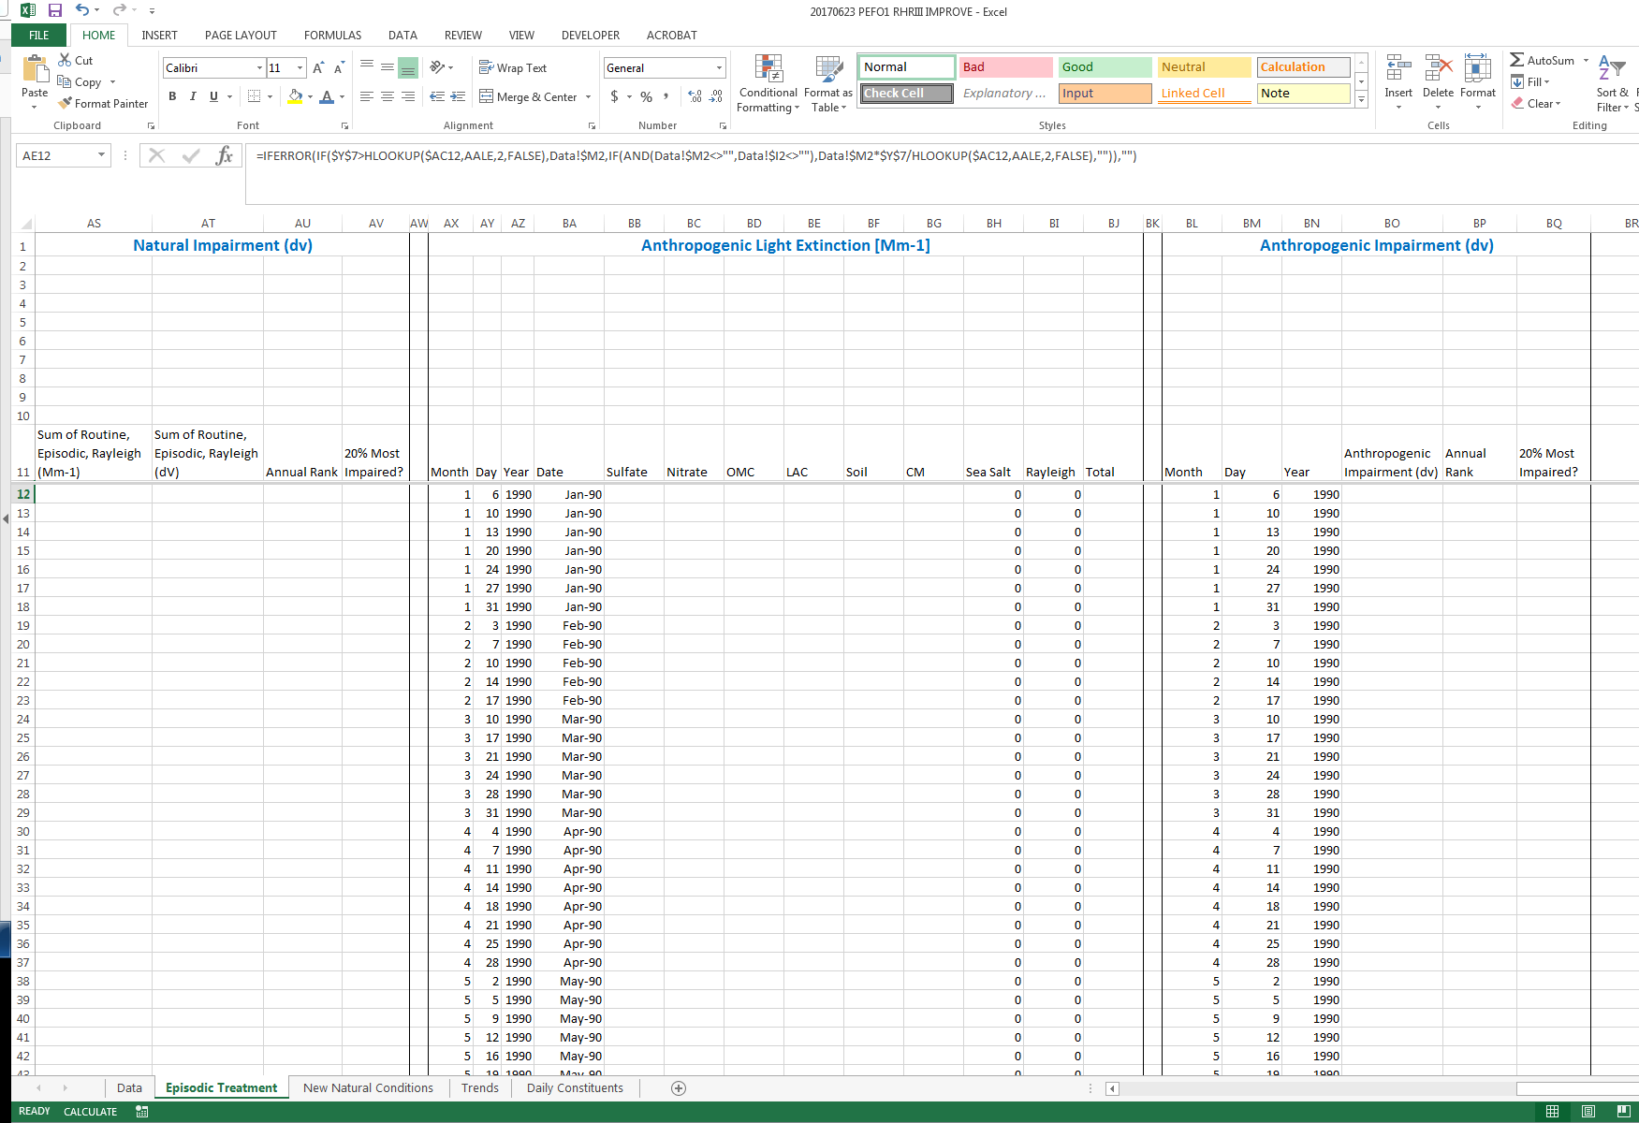
‘Episodic Treatment’ Worksheet Continued
Natural Impairment – Estimates the daily extinction (Mm⁻¹) and impairment (dv) attributable to natural routine and episodic emissions.
Anthropogenic Light Extinction - Estimates the daily extinction (Mm⁻¹) attributable to anthropogenic emissions, Step E of the Guidance.
Anthropogenic Impairment - Estimates impairment (dv) attributable to anthropogenic emissions and ranks each day of the year to determine the 20% most impaired days, Step F of the Guidance.

Slide 13

‘Trends’ Worksheet
Natural Conditions – Estimated using the routine and episodic natural conditions on the 20% most impaired days, Section 2.1 of the TSD
Clearest Day Trends – Estimates the annual average and 5-year rolling average for the 20% clearest days.
Most Impaired Days - Estimates the annual average and 5-year rolling average for the 20% most impaired days.
Visibility Thresholds – Estimates the average rate of progress, the uniform rate of progress, and establishes annual thresholds for the clearest and most impaired days.

Slide 14
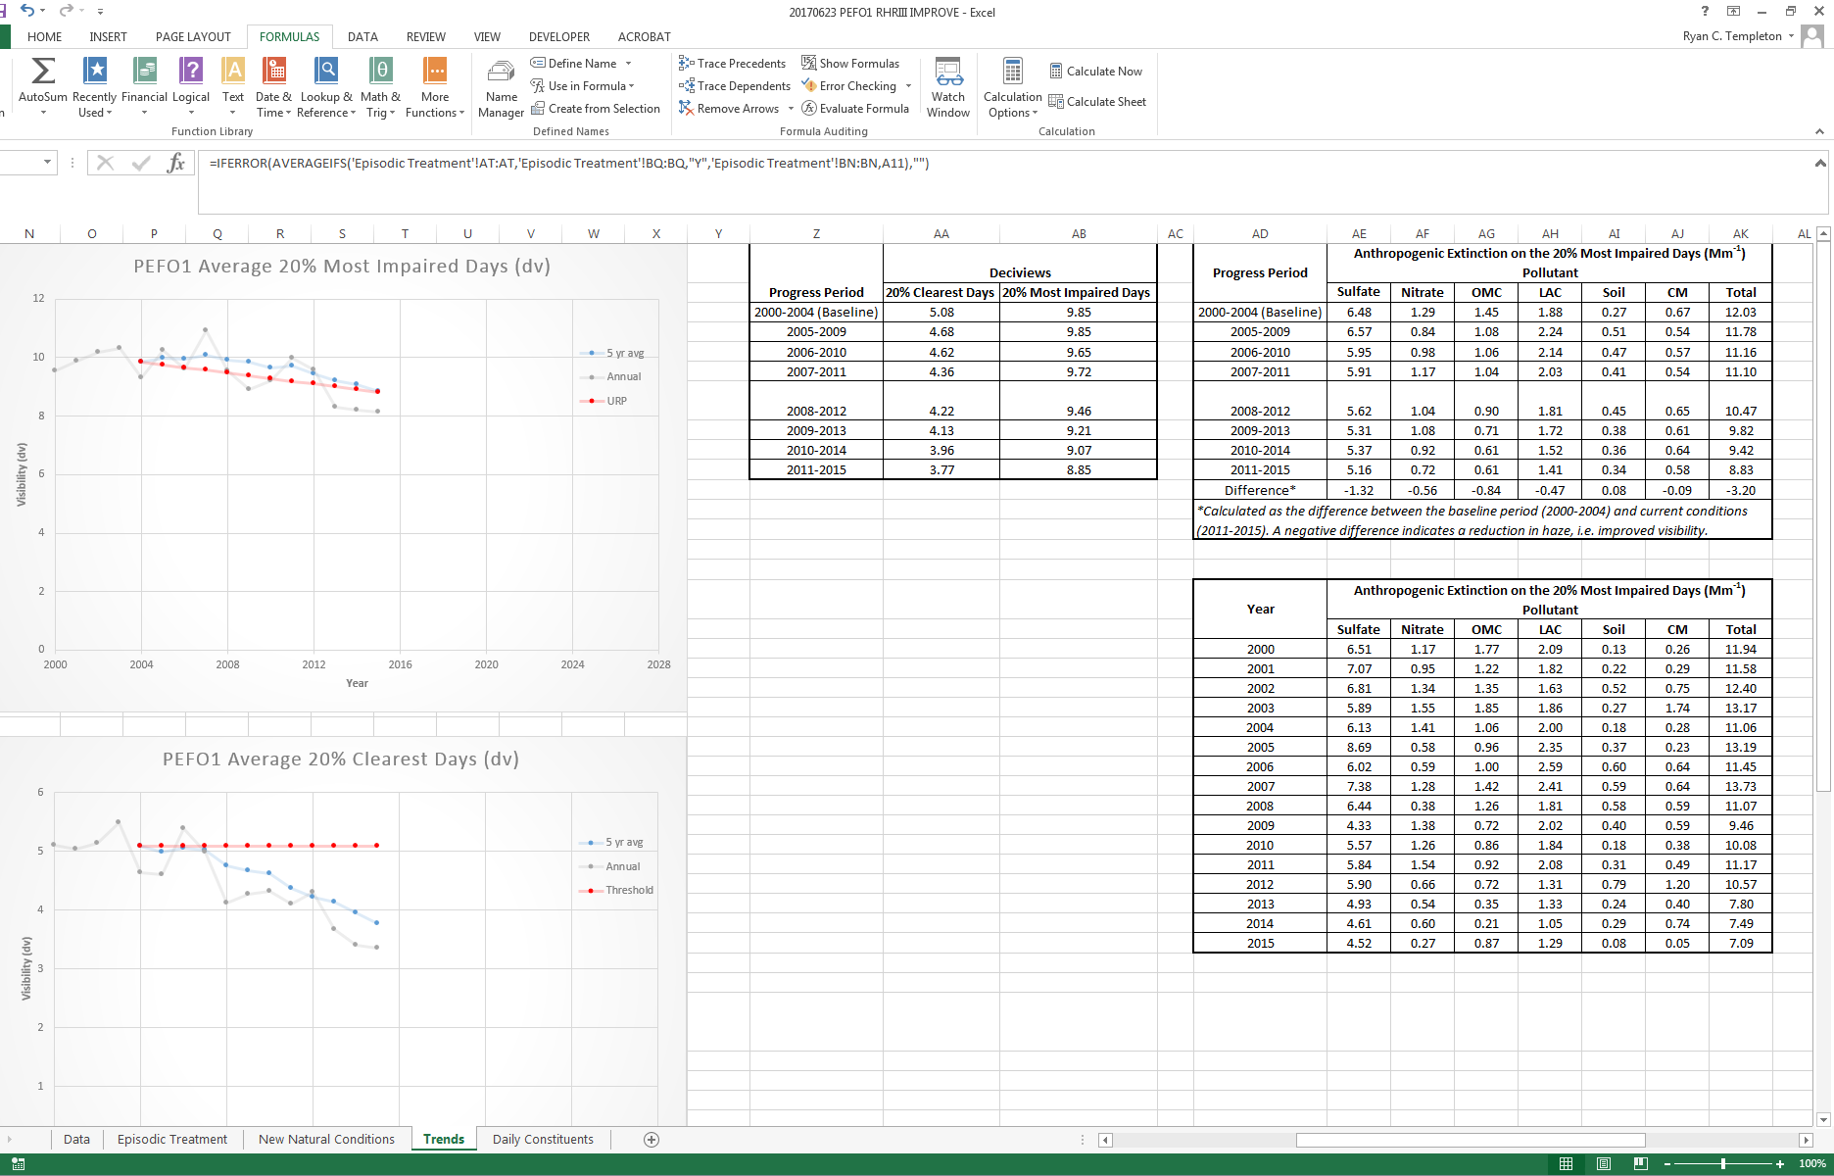
‘Trends’ Worksheet Continued
This worksheet also creates a number of useful graphics and tables for Regional Haze documentation, including:
  Graphical and tabular, annual and 5-yr rolling averages of clearest and most impaired day
  Tables of annually and 5-yr averaged anthropogenic extinction for each pollutant
  Tables of pollutant light extinction rankings

Slide 15
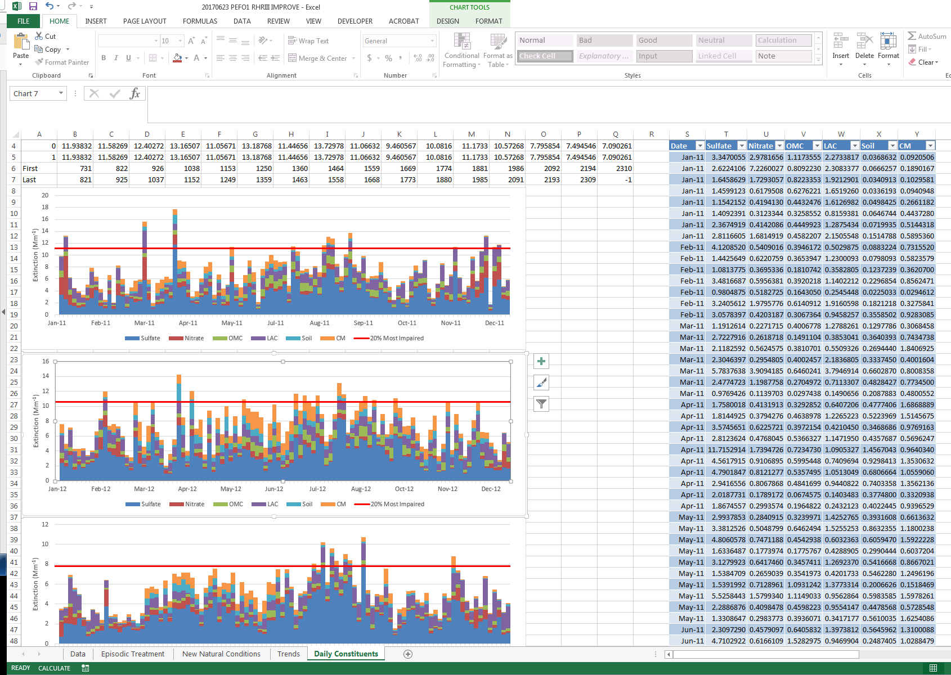
‘Daily Constituents’ Worksheet
This worksheet provides a graphical look at the daily pollutant contributions to light extinction for the years 2011-2015.

Slide 16
Workbook bugs/issues
When data is missing for a monitor, the user may need to manually revise some of the graphs and possibly the URP calculation.
For those sites processed that are missing considerable amounts of data (e.g. multiple years in the baseline period), I have not always been able to recreate EPA’s results published in the TSD.
The spreadsheet does not adjust the URP for prescribed fire or international emissions. A method will needed to be developed by the workgroup to estimate these effects.
Any other bugs the group has found?

Slide 17
Workbook flexibility
The workbook currently allows the user to adjust the dust and carbon extreme episodic event threshold. This is important for establishing a more accurate threshold for a given monitor rather than the current “one size fits all” approach.
What other flexibility is important? Examples:
  Sulfate and nitrate thresholds?
  Altering the natural conditions methodology?
  …?

